Slide 2


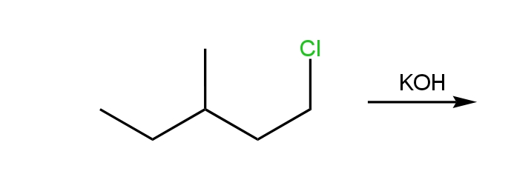

Click for Answer!
Click for question

Slide 3

